Slide 1


8. Towards an integrated view of the immune system
by Bruno Lemaitre,
Ecole Polytechnique Fédérale de Lausanne
Web: http://ghi.epfl.ch

Slide 2
Humoral and cellular immunity
Cellular and humoral branches of the immune system play different roles in protecting the host:
 | Humoral immunity | Cell-mediated immunity
Directed against | extracellular pathogens | intracellular pathogens or “altered“ self (e.g. tumors)
Effector mechanisms | antibodies | antigen-specific cells (CD4+ Th cells and CD8+ CTLs) non-specific cells (NK cells, macrophages, neutrophils, eosinophils) cytokines that support cell-mediated immunity

Slide 3
Interplay between cellular and humoral immunity
Interplay between humoral and non-specific cellular immunity:
  Fc receptors (FcR) on NK cells, macrophages and neutrophils bind to antibody-coated pathogens for destruction
Interplay between humoral and specific cellular immunity:
  Th cells interact with B cells to promote antibody isotype switch (T/B collaboration)
Interplay between specific and non-specific cellular immunity:
  cytokines secreted by either arm of immunity influence the other arm
  macrophages and dendritic cells are APCs for specific T cells

Slide 4



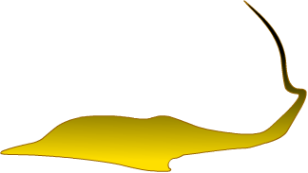

Classes of disease-causing agents
Bacteria | Viruses | Protozoans | Worms | Fungi
Salmonella | HIV (AIDS) | Plasmodium (Malaria) | Schistosoma (dermatitis, hepato-, splenomegaly) | Dermatophytes (cutaneous mycosis)
Shigella (dysentery) | Influenza (Flu) | Leishmania (cutaneous lesions) | Tenia (asymptomatic) | Saprophytes (subcutaneous mycosis)
Staphylococcus aureus | HAV, HBV (Hepatitis) | Trypanosoma (sleeping sickness, Chagas disease)
Pneumococcus (otitis, pneumonia) | Rotavirus (diarrhea) | Toxoplasma gondii (fetal abnormalities)
 |  | Entamoeba histolytica (dysentery)
 |  | Cryptosporidium parvum (diarrhea)

Slide 5
Different types of adaptive immune responses
 | Humoral immunity | Cell-mediated immunity
Typical pathogens | Clostridium Staph. aureus Strep. pneumoniae Polio Pneumocystis Trichinella | Vaccinia Influenza Rabies Listeria | Mycobacteria Leishmania Pneumocystis
Location | Extracellular fluid | Cytosol | Macrophage vesicles
Effector T cells | Th1 and Th2 cells | Cytotoxic CD8 T cells | Th1 cells
Antigen recognition | Peptide-MHC class I complex on antigen-specific B cell | Peptide: MHC class I complex on infected cell | Peptide: MHC class I complex on infected macrophage
Effector action | Activate specific B cells to produce antibodies | Kill infected cell | Activate infected macrophages
Adapted from: Immunobiology, 6th ed. Garland Science 2005

Slide 6
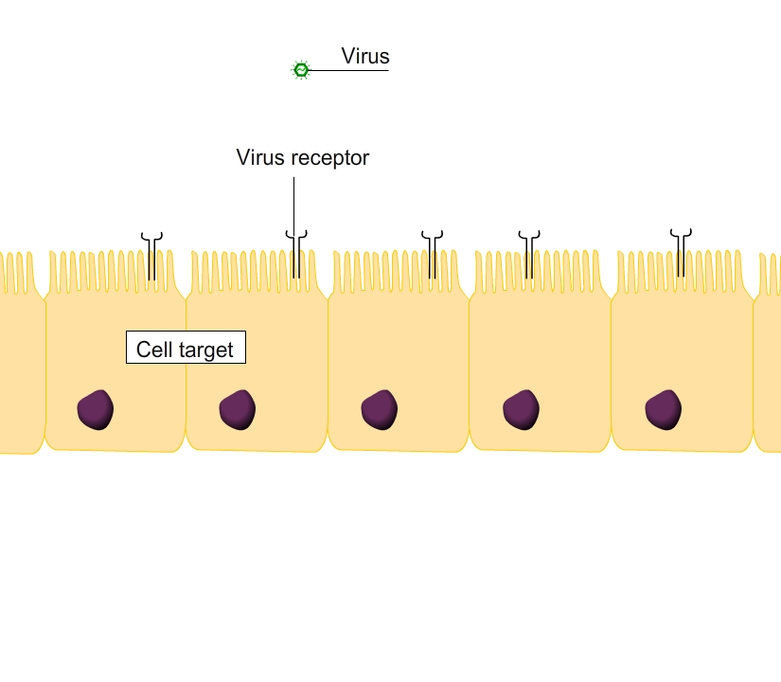
Defence against microbes
Viral infection |  | Bacterial infection |  | Parasitic infection
Cytopathogenic | Non- cytopathogenic | Extracellular | Intracellular | Protozoan | Helminths
Antibodies | CTL | Antibodies | Antibodies + CTL | Antibodies + CTL | IgE antibodies
Cytopathogenic Virus

Slide 7
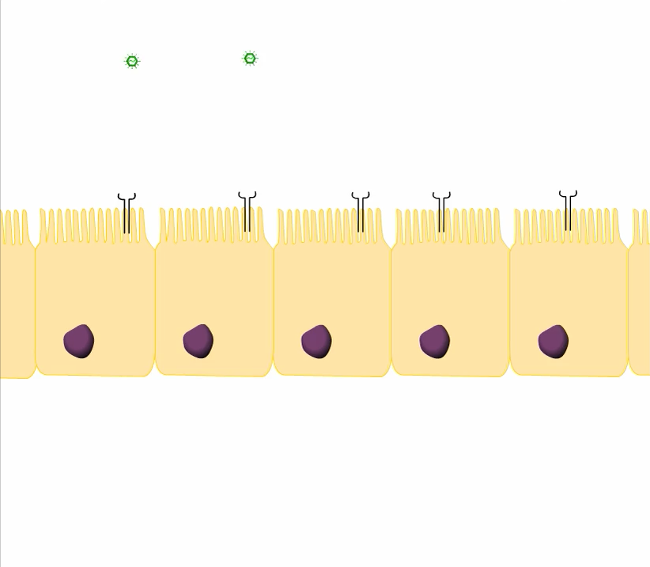
Defence against microbes
Viral infection |  | Bacterial infection |  | Parasitic infection
Cytopathogenic | Non- cytopathogenic | Extracellular | Intracellular | Protozoan | Helminths
Antibodies | CTL | Antibodies | Antibodies + CTL | Antibodies + CTL | IgE antibodies
Non-cytopathogenic Virus

Slide 8
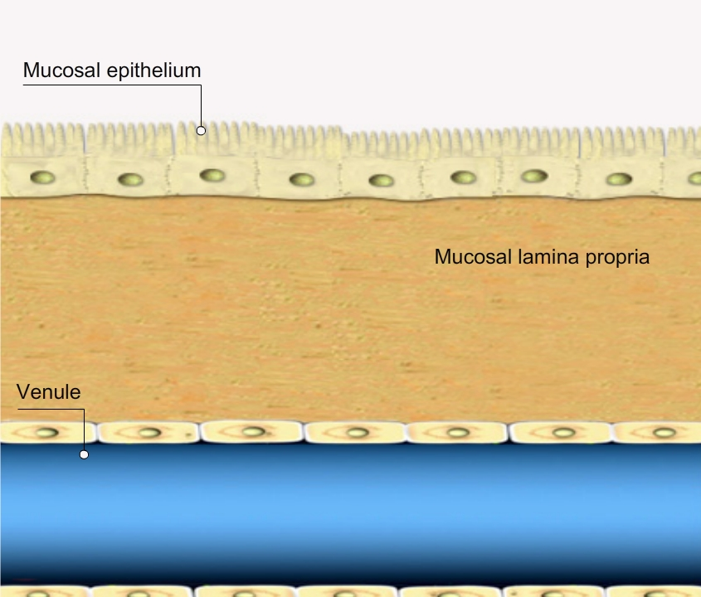
Defence against microbes
Viral infection |  | Bacterial infection |  | Parasitic infection
Cytopathogenic | Non- cytopathogenic | Extracellular | Intracellular | Protozoan | Helminths
Antibodies | CTL | Antibodies | Antibodies + CTL | Antibodies + CTL | IgE antibodies
Neutralization

Slide 9
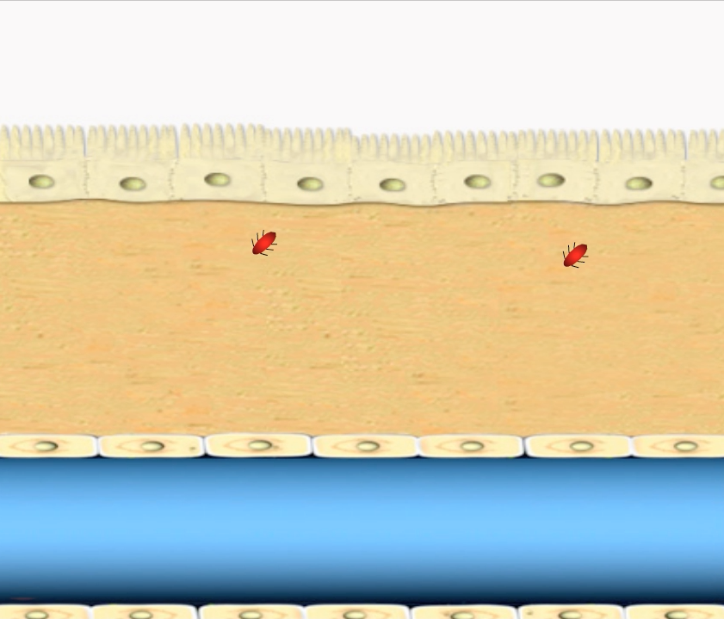
Defence against microbes
Viral infection |  | Bacterial infection |  | Parasitic infection
Cytopathogenic | Non- cytopathogenic | Extracellular | Intracellular | Protozoan | Helminths
Antibodies | CTL | Antibodies | Antibodies + CTL | Antibodies + CTL | IgE antibodies
Phagocytosis

Slide 10
An integrated view of the immune system
Example: infection by a respiratory virus

Slide 11
Lung
Lymph nodes
Early
(hours)
Viral replication within host cells
Recognition by PRR (TLR3/Cgas)
Secretion of IFNα/β
Activation of neighbouring host cells by IFNα/β
Secretion of vasoactive and chemotactic factors
Infiltration of innate immne cells (neutrophils, NK cells, monocytes)
Mid
(days)
Activation of dendritic cells (DCs)
DC-mediated antigen uptake and trafficking to local lymphoid tissue
Activation of NK cells
Secretion of IFNγ by NK cells
Activation of naïve T cells by DCs
Lysis of infected host cells by NK cells
Apoptosis of neutrophils
T-B cognate interactions
Production of antiviral IgM
Late
(weeks)
Infiltration of effector T cells
Production of antiviral IgG
Re-activation of effector T cells
Apoptosis of effector B cells
Lysis of infected host cells by CTLs
Neutralization by antibodies
Antibody-dependent cellular cytotoxicity
Antigen clearance and resolution of inflammation
Apoptosis of effector T cells

Slide 12
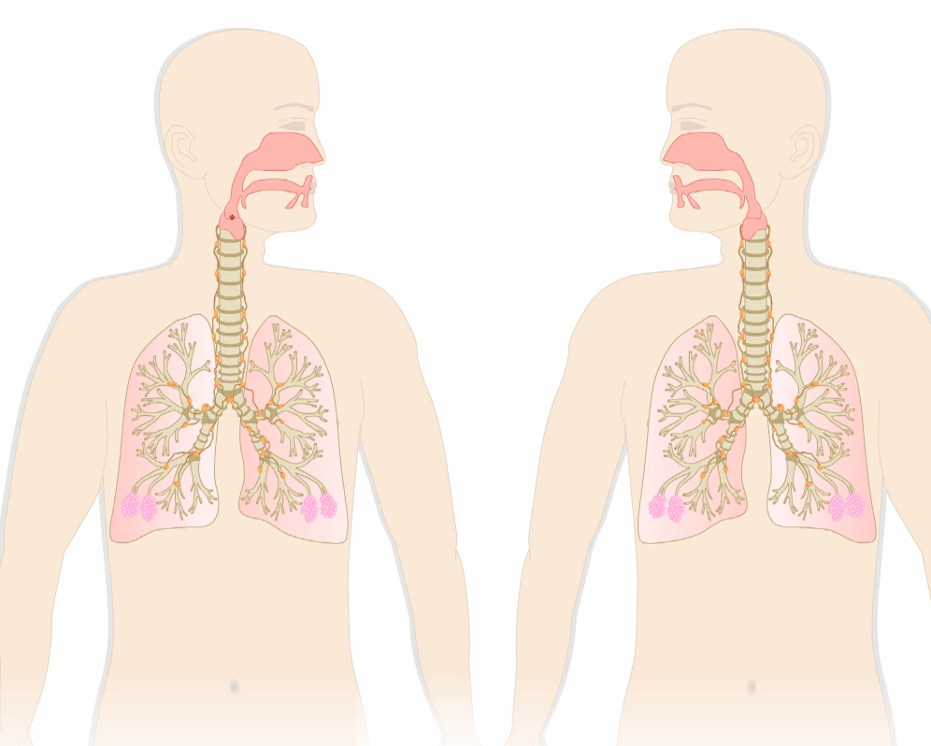

Slide 13
Hot Topics in Immunology Research
Immuno-metabolism
Ontogeny of the immune system
Immuno-aging
Evolution of the immune system
Mucosal immunology - Microbiota
Inflammation and diseases (metabolic, neurodegeneration)
Imaging of the immune system
Central and peripheral haematopoiesis
Immunity to infection
Immunology and human populations
Immunotherapy

